Slide 1
UNIVERSITY SUCCESS ANALYSIS
PARUL MALHOTRA

Slide 2
OVERVIEW
This report investigates various dimensions related to universities and their correlations with economic indicators, demographics, ranking criteria, and gender distribution. Key findings and insights are presented to provide a comprehensive understanding of the dynamics within the higher education landscape.

Slide 3
0BJECTIVE
The project will involve the following tasks:
Performing a comprehensive analysis of university rankings, including variations across systems, key factors influencing rankings, historical trends, and the impact of limitations and biases on rankings
Deriving meaningful conclusions and recommendations for improving ranking methodologies.
Compiling analysis results, conclusions, and recommendations for stakeholders .

Slide 4
THE PROCESS
: Data Acquisition from GitHub.
: Data Transformation and Enhancement.
: Connecting with Power BI, Excel, and MySQL Workbench.
: Problems Statement Solution in Power BI
: Exploratory Data Analysis (EDA)
: Creation of Visuals
: Detailed Documentation

Slide 5
Table: Country:
Fields:
id: Unique identifier for each country.
country name: Name of the country.
Gdp: it is a key economic indicator of various countries.
Population: total number of people living in specific countries.
Table: University:
Fields:
id: Unique identifier for each university.
university name: Name of the university.
Country_id: Foreign key referencing the country id field in the Country table.
Table: Ranking system
Fields:
id: Unique identifier for each ranking system.
ranking system name: Name of the ranking system.

Slide 6
Table: Ranking criteria
Fields:
id: Unique identifier for each ranking criterion. ranking criteria
Criteria_name: Name of the ranking criteria.
ranking_system_id: Foreign key referencing the ranking system id field in the Ranking system table.
Table: University year
Fields:
university id: Foreign key referencing the university id field in the University table.
number of students: Number of students in the university for a specific year.
female population: Population of female students in the university for a specific year. .
international population: Population of international students in the university for a specific year.
Student to staff ratio: Ratio of students to staff members in the university for a specific year.
Score: Score of the university for a specific ranking criteria and year.
Year: Year of scoring for the university.

Slide 7
Table: University ranking year
Fields:
ranking criteria_id: Foreign key referencing the ranking criteria id field in the Ranking criteria table.
university_id: Foreign key referencing the university id field in the University table.
Score: Score of the university for a specific ranking criteria and year.
Year: Year of scoring for the university.
ranking_system_id: Foreign key referencing the ranking system id field in the Ranking system table.

Slide 8
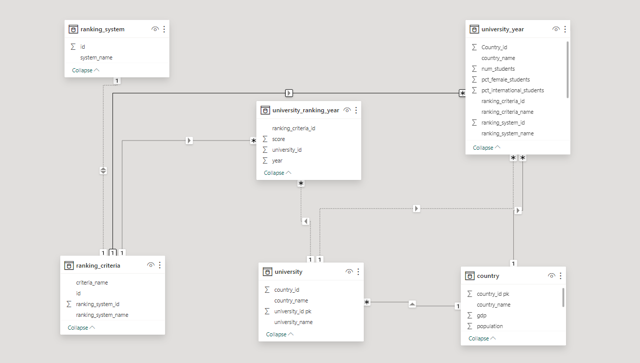

Slide 9
Power BI Problem Statements:

Slide 10
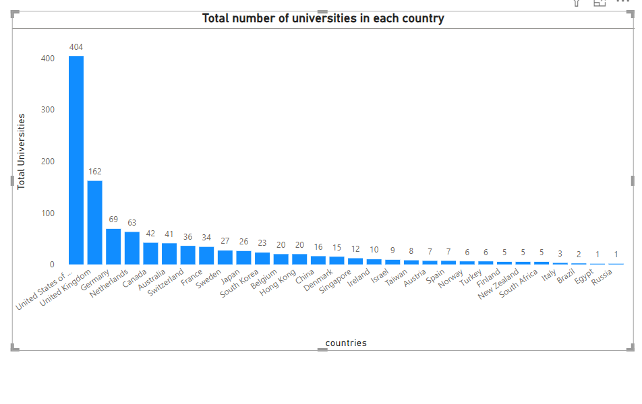
Countries like the United States, United Kingdom stand out with a significant presence of universities, which reflects their substantial investment in education and research.

Slide 11
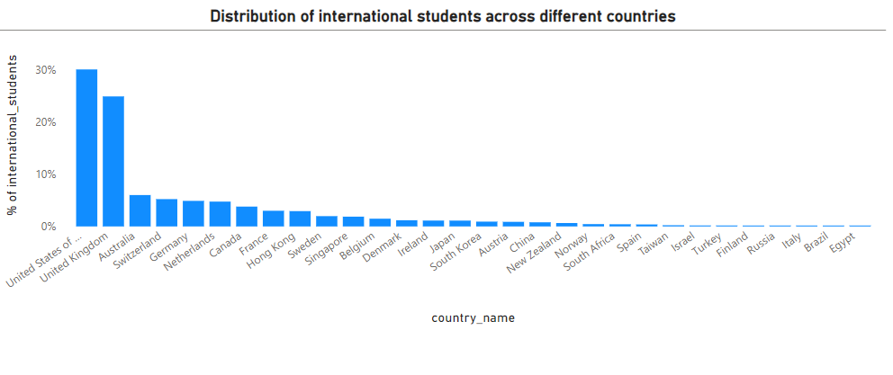
Countries such as the United States, the United Kingdom, Australia are prominent choices for international students due to their extensive academic offerings and inclusive atmospheres. In contrast, Finland, Russia, and Italy tend to draw fewer international students, possibly due to language barriers or limited program options.

Slide 12
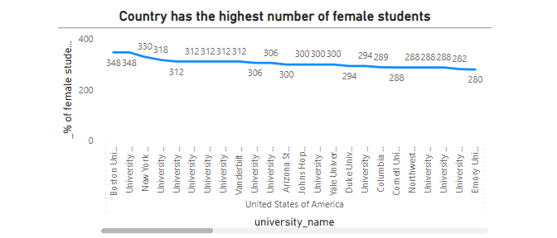
This data highlights the United States as leaders in promoting gender equality

Slide 13
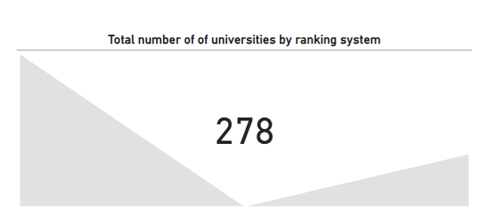
This kpi chart illustrates total number of universities are distributed across various ranking systems.

Slide 14
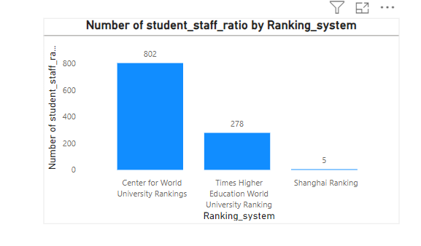
This chart shows that the number of students and staff under the ranking system .

Slide 15
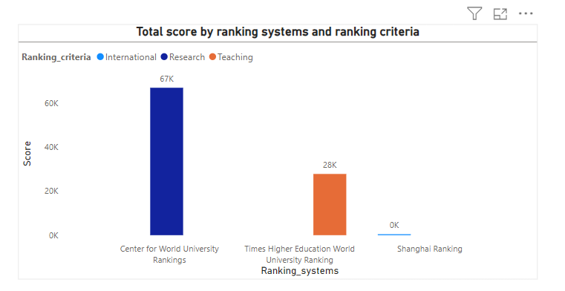
This chart shows, it is evident that the CWUR ranking places the highest importance while the Shanghai Ranking places the lowest importance.

Slide 16
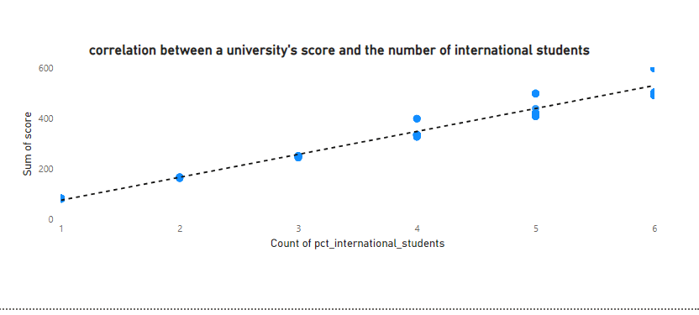
There is positive correlation between a university's score and the number of international students

Slide 17
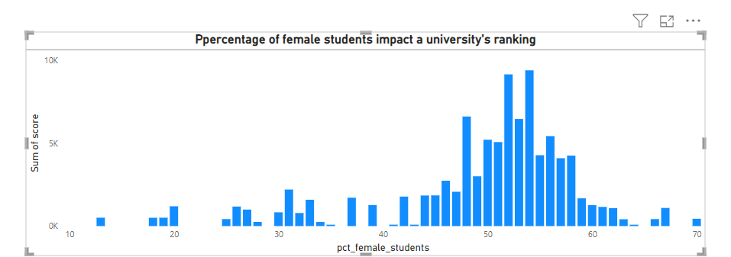
This chart shows that score is below 10k the more numbers of female students are university get like 50 to 60 percent.

Slide 18
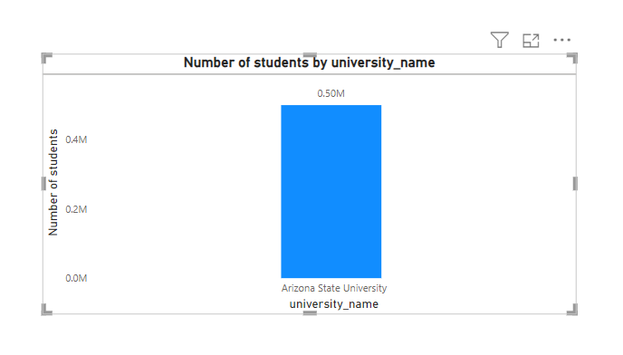
This chart clearly shows that Arizona State University boasts the highest student enrollment among all universities.

Slide 19
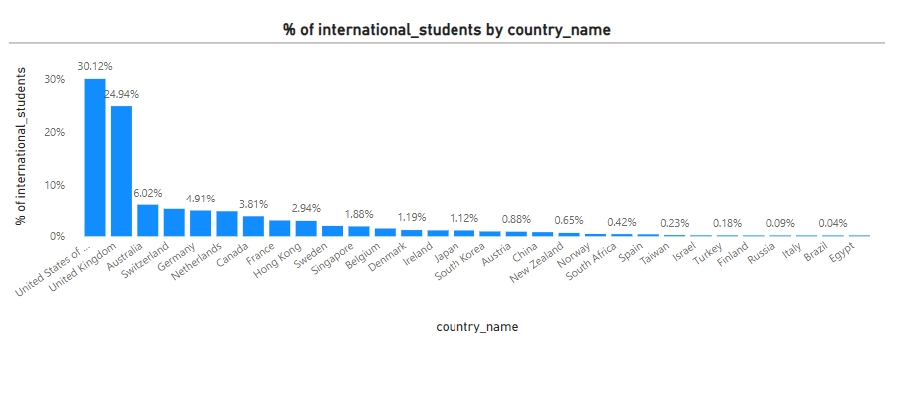
The creation of a chart displaying the percentage of international students for each university like United States and United Kingdom having higher %.

Slide 20
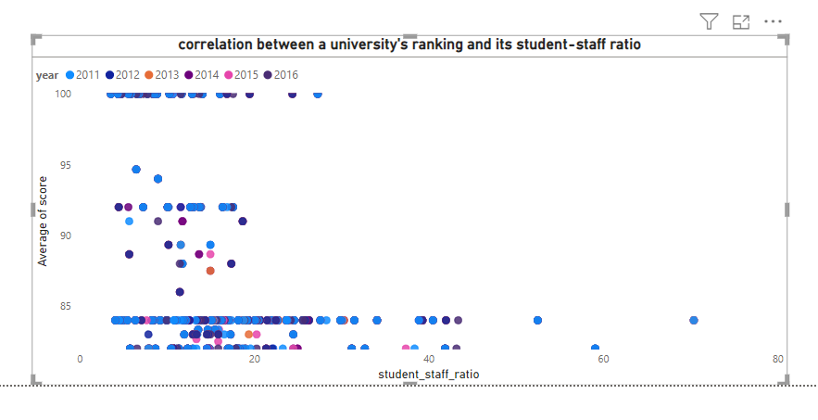
there is no relationship between a university's score and the student-staff ratio is equal to -0

Slide 21
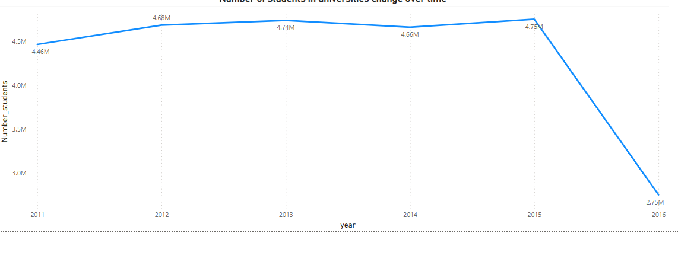
The creation of a bar chart reveals a compelling trend: between 2011 and 2016, there was a consistent and substantial increase in university enrollments worldwide. This growth exhibited a remarkable surge, particularly between 2011 to 2015.Suddenly shows fall during 2016.

Slide 22
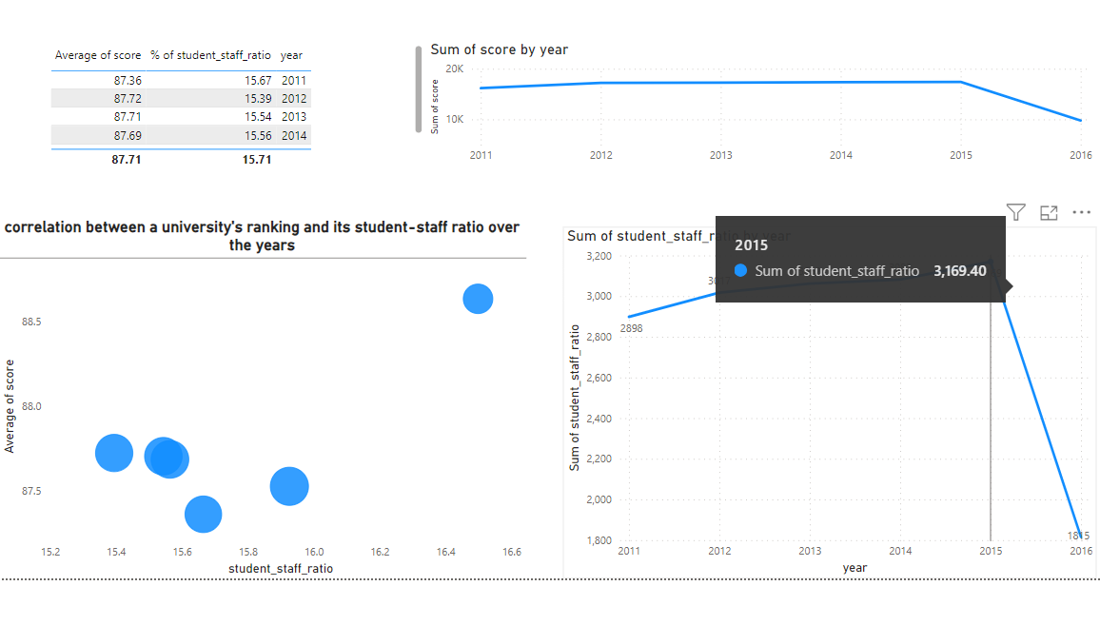
During the initial period there was relatively minimal fluctuation in the scores. However, a remarkable and sudden increase is observed in subsequent years, leading to a peak in performance. This spike is then followed by a noticeable decline between the year 2015 to 2016.In parallel, the student-to-staff ratio exhibited a consistent and stable pattern from 2011 to 2015, with minimal fluctuations. However, a significant and sudden surge in the ratio is observed thereafter, marking a departure from the earlier trend.

Slide 23
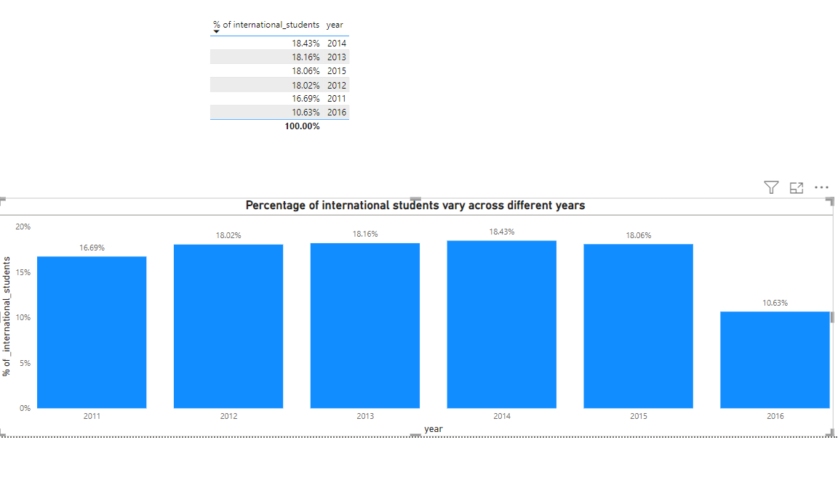
The analysis of the percentage of international students reveals a notable trend across the years.

Slide 24
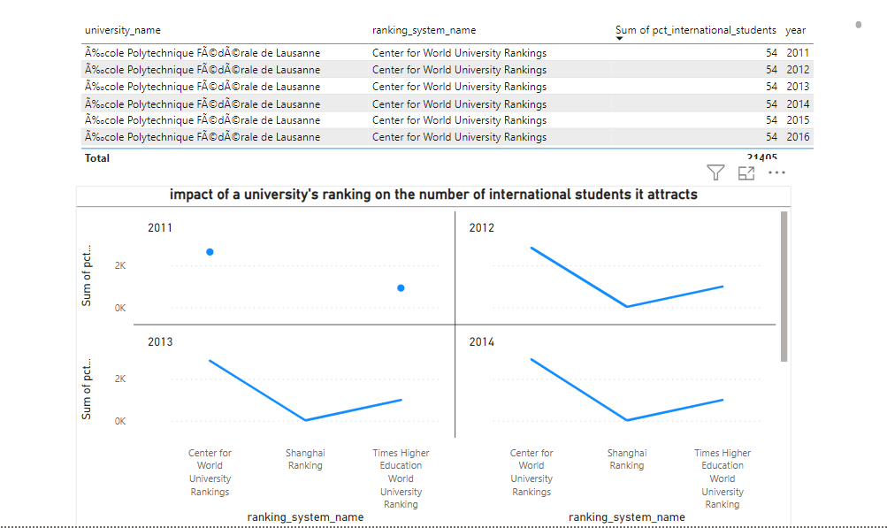
While there are many factors that influence a university's attractiveness to international students, its ranking can play a significant role

Slide 25
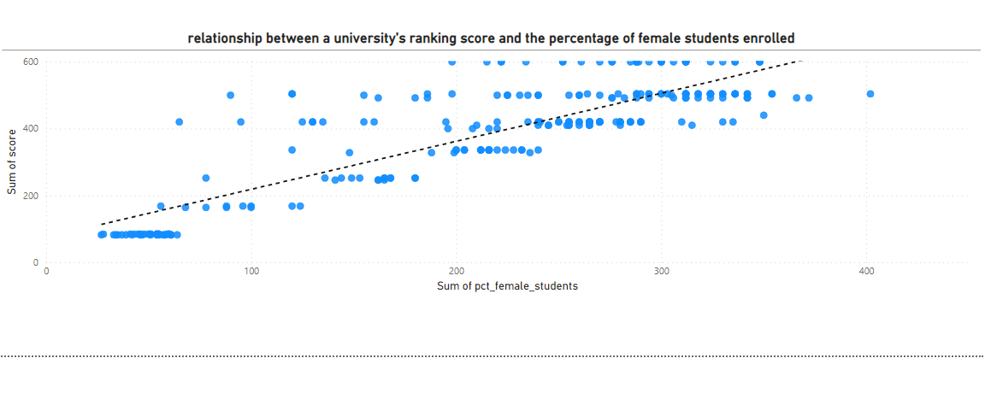
The analysis has unveiled a noteworthy connection between a university's ranking score and the percentage of female students in its enrollment. This association implies that universities boasting a higher proportion of female students tend to attain elevated ranking scores.

Slide 26
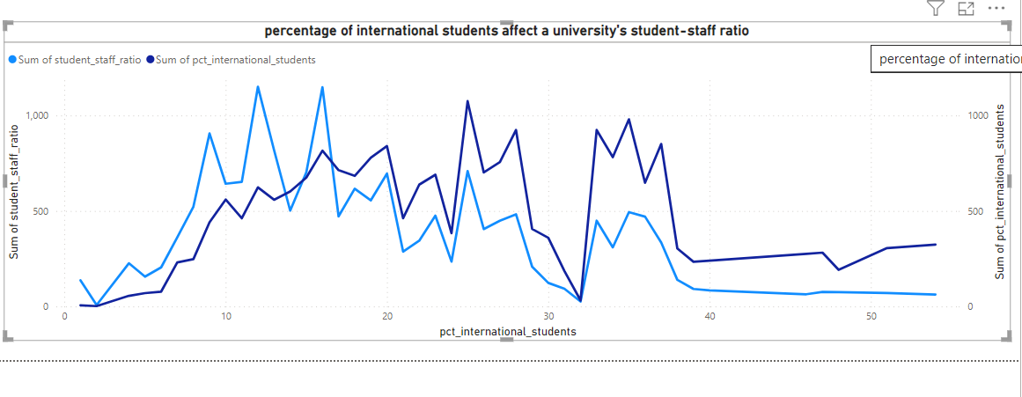
The percentage of international students in a university's student body can significantly impact the student-staff ratio. A higher proportion of international students often necessitates additional support services and staff to cater to their unique needs, potentially increasing the student-staff ratio.

Slide 27
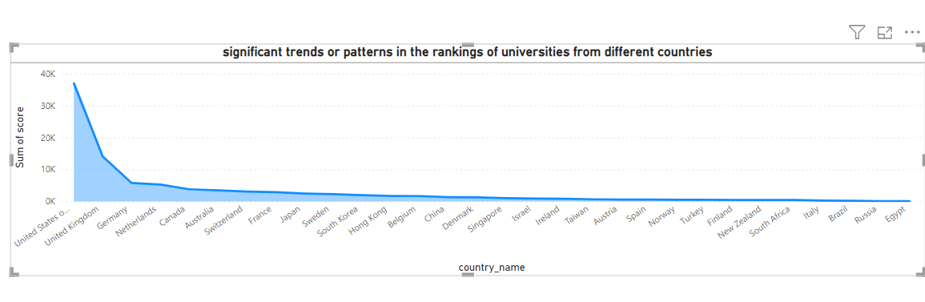
University rankings vary widely from one country to another, making it clear that there's no consistent pattern worldwide. The USA leads with the most ranked universities

Slide 29
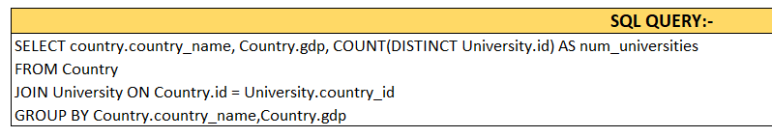
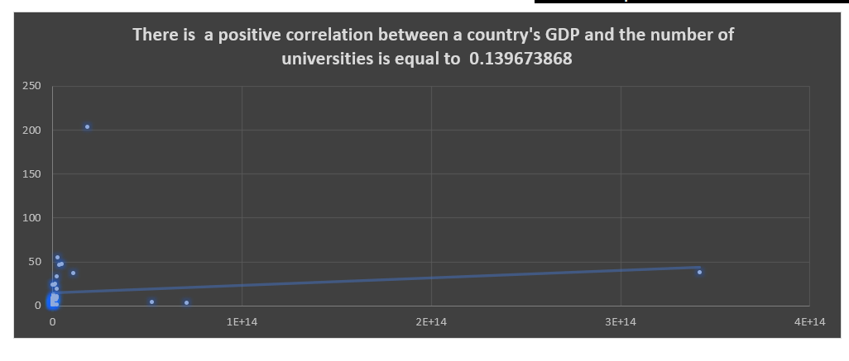
This section explores statistical analyses to determine if a correlation exists between a country's GDP and the number of universities.

Slide 30
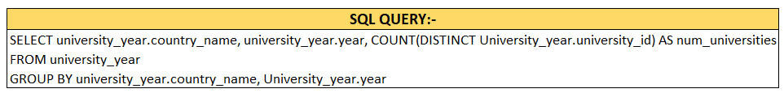
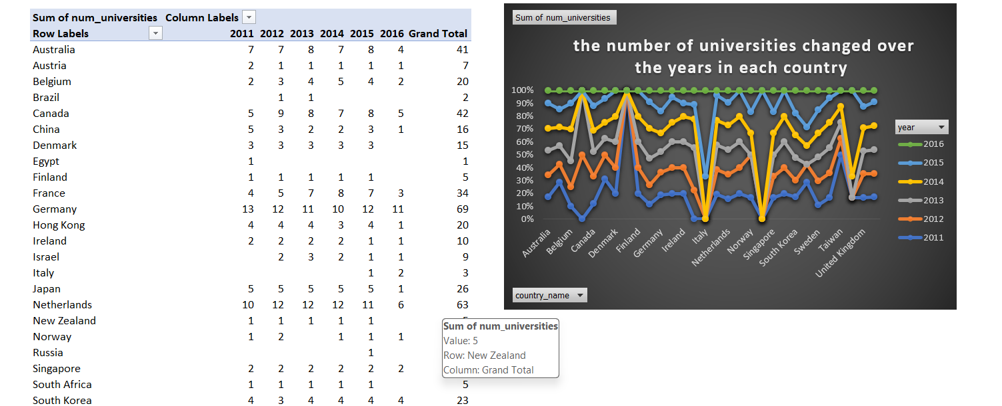
Examining historical data, this section analyzes how the number of universities has changed over the years in different countries. Trends and fluctuations are discussed to understand potential influencing factors.

Slide 31
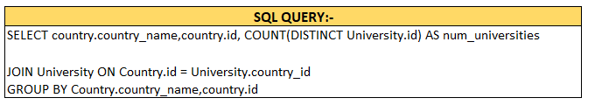
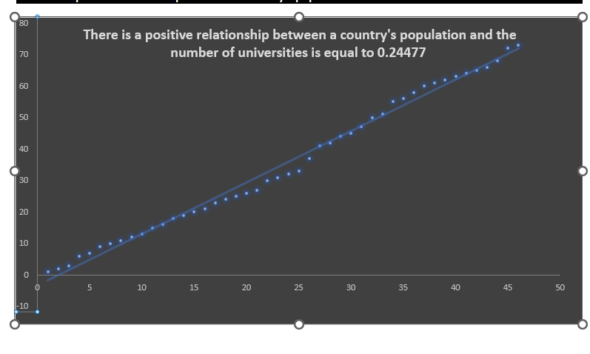
Investigating whether there is a relationship between a country's population and the number of universities. Population density and regional variations are considered to provide a nuanced perspective.

Slide 32
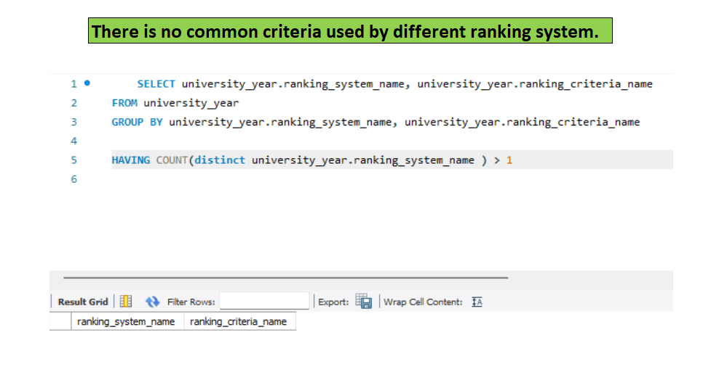
By Analyzing we can see from the above output we can conclude that there are no such common criteria used by ranking system. Each system tends to have its unique focus and priorities.

Slide 33
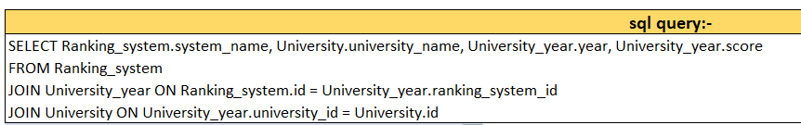
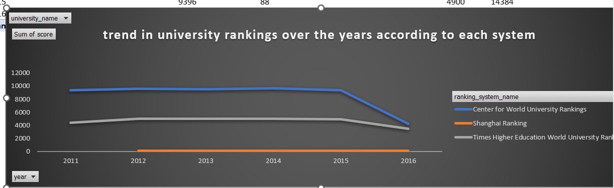
Times Higher Education system, the information provided lacks specific trends, leaving it unclear whether rankings have been stable or changing. In the case of the Shanghai Ranking, the insight notes less fluctuation, but it doesn't specify whether the rankings have remained consistently high or have experienced gradual changes. On the other hand, the Center for World University Rankings saw a significant event in 2014, with a sudden increase in rankings, indicating a notable positive shift.

Slide 34
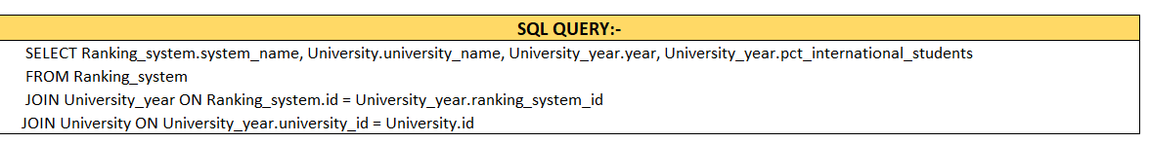
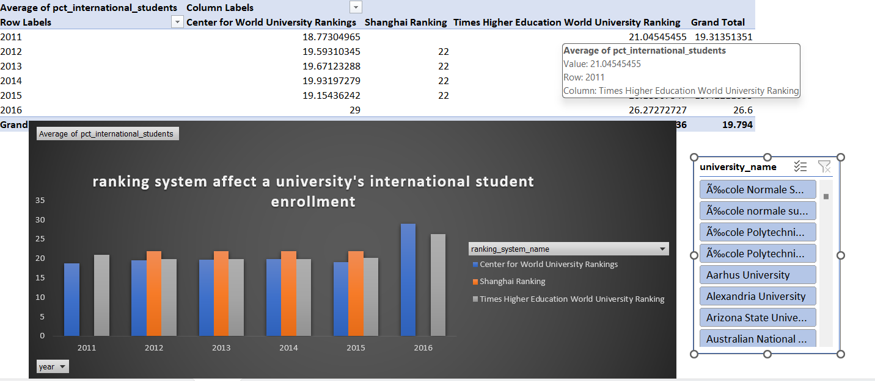
The Shanghai Ranking system, characterized by consistent growth in international student numbers over the years, tends to attract more students due to its perceived academic excellence. In contrast, the Times Higher Education World University Ranking shows minimal fluctuations, suggesting that this ranking has less impact on international student recruitment. On the other hand, the Center for World University Rankings typically reports lower international student enrollments

Slide 35
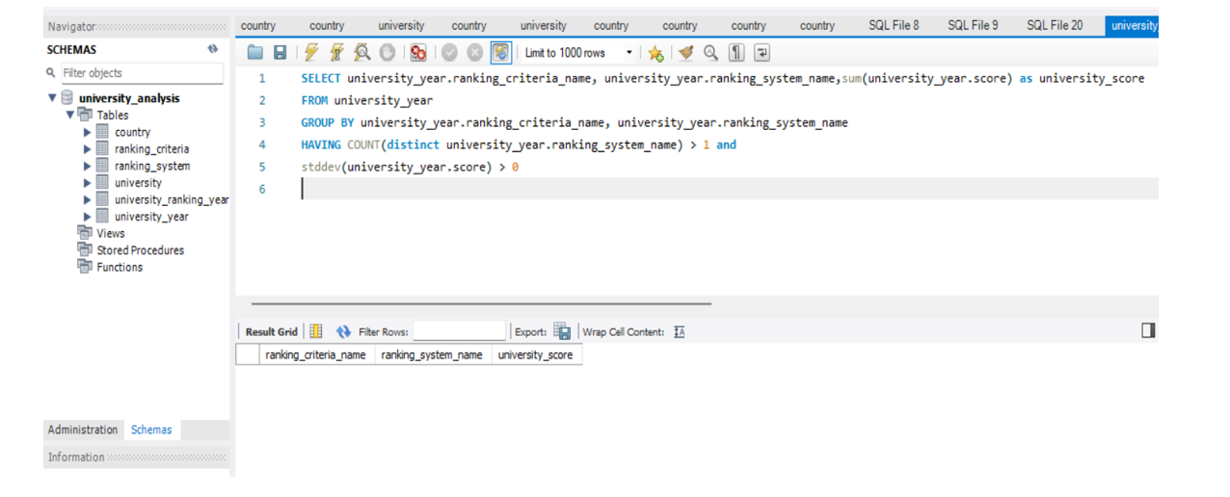
Examining various ranking systems uncovers a notable absence of universally accepted criteria. Each system tends to prioritize distinct aspects, such as academic excellence, research productivity, faculty qualifications, student-to-faculty ratios, and other relevant metrics. This diversity of criteria underscores the flexibility of ranking systems.

Slide 36
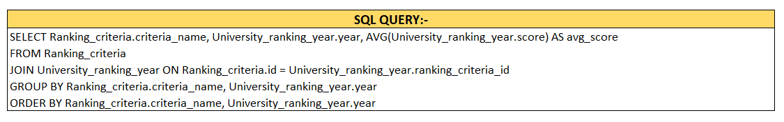
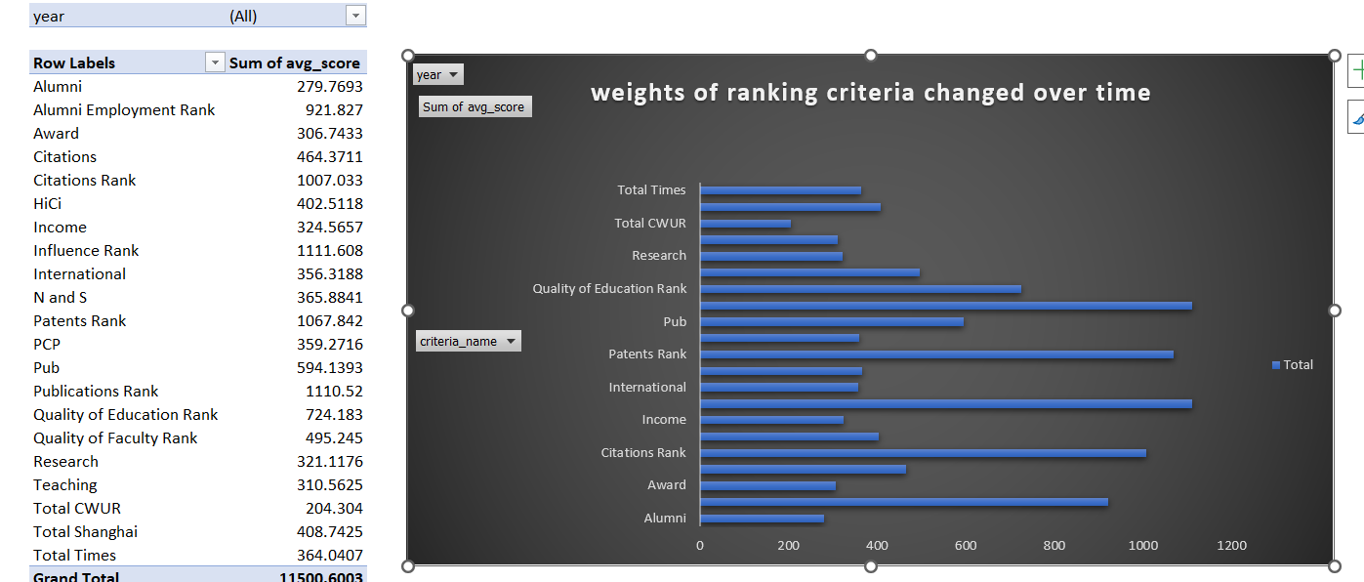
An examination of how the weights assigned to different criteria in ranking systems have changed over the years. This helps in understanding evolving trends in evaluating university performance.

Slide 37
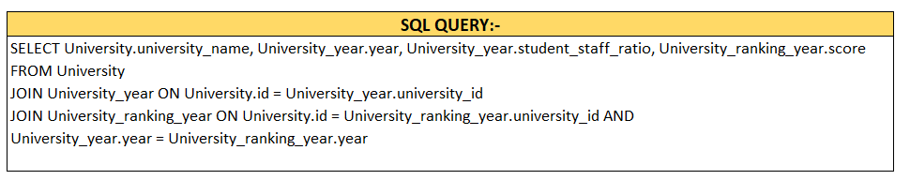
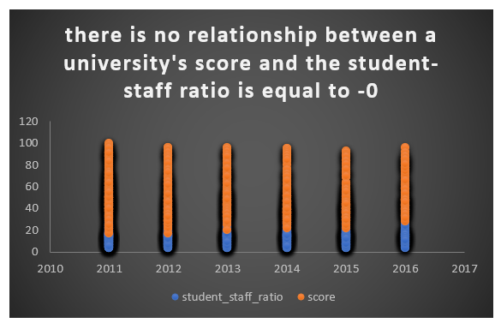
Investigating if there is a correlation between a university's overall score and its student-staff ratio. This section explores potential implications for resource allocation and educational quality.

Slide 38
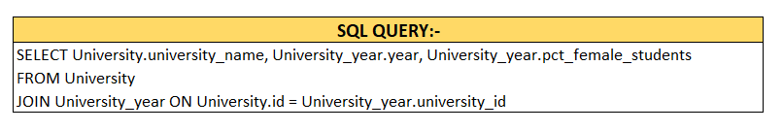
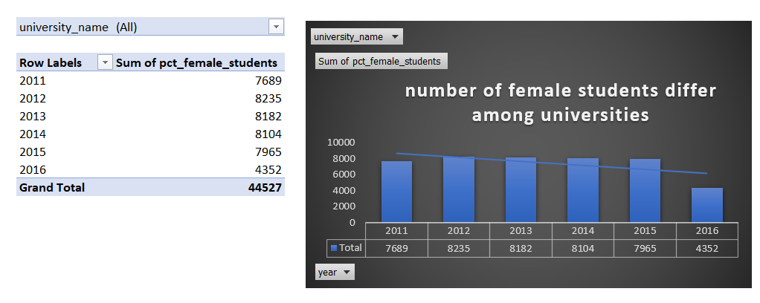
By Analyzing we can see, The number of female students varies among universities. Some universities have a more balanced gender ratio, with a relatively equal number of male and female students, while others may have a skewed ratio, either with more female or male students.

Slide 39

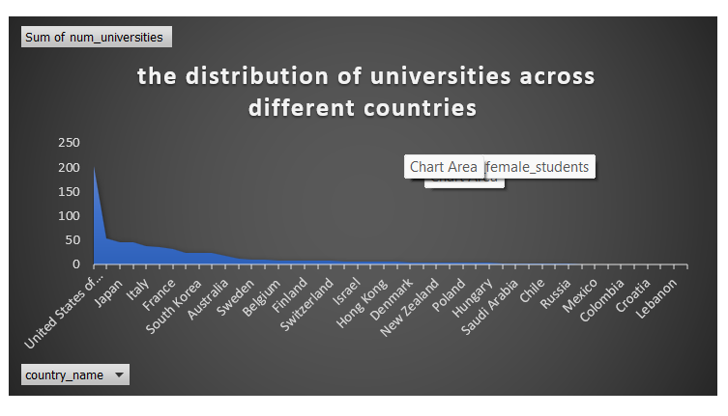
The distribution of universities across different countries is highly uneven. The United States of America has the highest number of universities, with 203 institutions, indicating a strong presence in higher education. In contrast, many other countries have fewer than 30 universities, highlighting the concentration of higher education institutions in a select few nations.

Slide 40
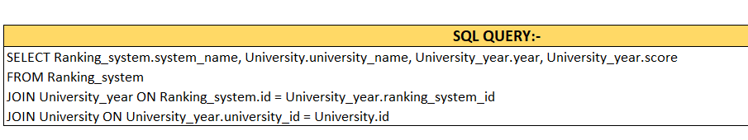
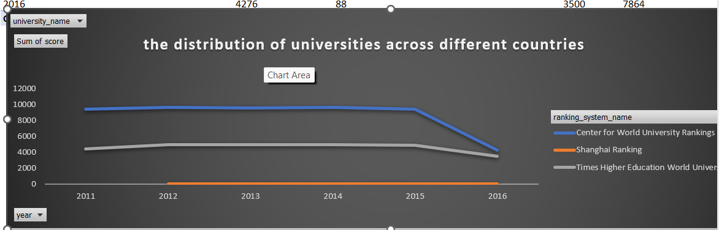
By analyzing we can see ,The ranking of universities has exhibited notable trends over the years. From 2011 to 2016, there was relatively little fluctuation, suggesting a period of stability in university rankings. However, in 2015, there was a sudden rise in the rankings, possibly indicating improvements or changes in university performance, followed by a significant drop in 2016, which may suggest a decline in rankings or increased competition.

Slide 41
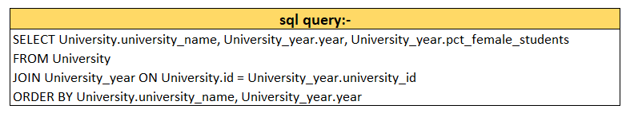
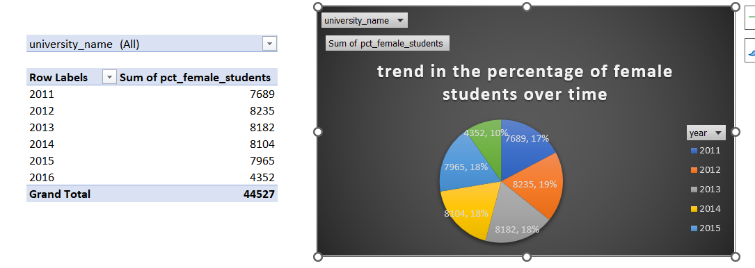
The trend in the percentage of female students over time exhibits relative stability from 2011 to 2015, with only slight fluctuations. However, in 2016, there is a sudden drop in the percentage of female students.

Slide 42
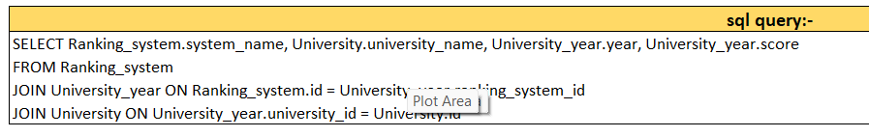
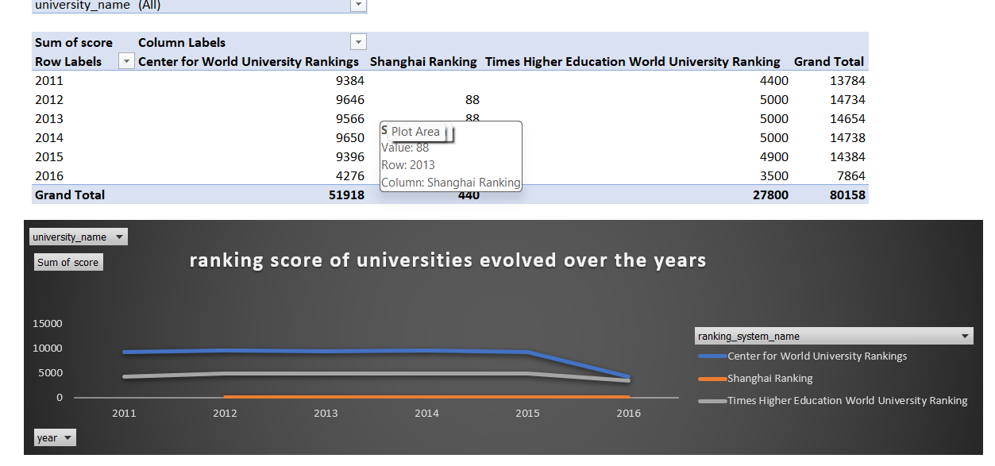
The ranking scores of universities have shown a relatively stable period with minimal fluctuations from 2011 to 2014. During this time, there was gradual, steady improvement in scores. However This was followed by a sharp drop in 2015, suggesting a sudden decline in the perceived quality of these universities

Slide 43
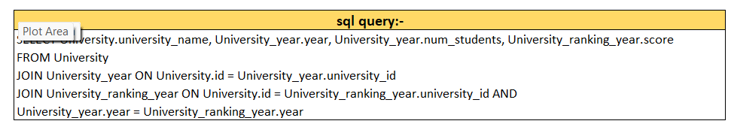
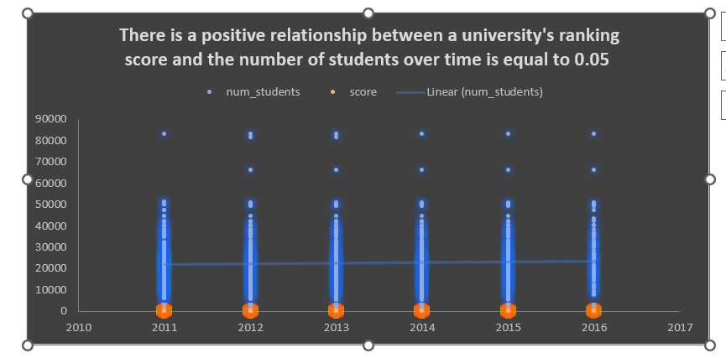
By analyzing we can see there is a positive correlation exists between the average ranking score and the average number of students. this section provides a comprehensive overview of the relationships explored in the report. Implications for policymakers, universities, and researchers are discussed.

Slide 44
In this project, we explored global based dataset on university ranking. The research ability has a clear impact on university ranking. High rank universities produce consist high impact publications. For low ranking universities, they may have a few labs that will produce high quality research findings. As a result, there is a large variation in publication scores of low ranking universities. Student staff ration does not show a clear relation with university ranking. Most high ranking universities are from developed countries, with U.S. dominate the ranking. Population of a country does not seem to have a linear relation with number of high ranking universities. China and India are not among the top 10 countries with most high-ranking universities. The producer of the ranking does impact the result. U.K. based ranking favor more U.K. based universities. This can be viewed as a bias. Asian countries do not score well in universities ranking. It is likely that the ranking standards may not in line with the strength of Asian countries.

